Slide 1
How Bad Has COVID-19 Been for the Stock Market?
By: Jacob Avchen, Jacob Hollander, and Salvatore Russo

Slide 2
Question 2:
How do the Different Industry Averages Compare to the Market as a Whole during the crash caused by COVID-19?
We examine the sampling of 5 ETFs meant to represent averages from different industries and compare them to the DOW Jones Industrial Average and S&P 500 Indexes to see their performance after the 2020 market crash caused by COVID-19. (2/20/20)
We will look at how the ETFs compare to the industrial averages as a whole. Some ETFs performed better than the industrial averages after the crash, and others performed worse.
We are looking at the automobile industry, the Food & Beverage industry, the Telecommunications industry, the Retail industry, and the Commodities industry.
The following slides will show how these ETFs compare to the DOW Jones Industrial Average and S&P 500 Indexes.

Slide 3
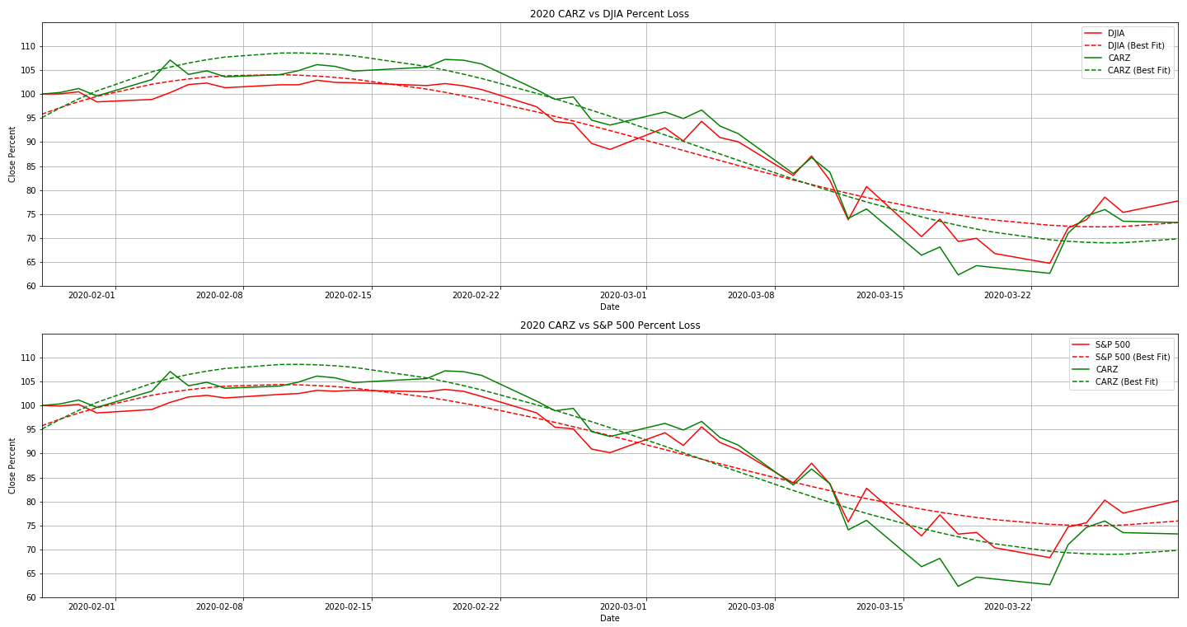
CARZ vs Dow Jones and S&P 500
(Automotive Industry)

Slide 4
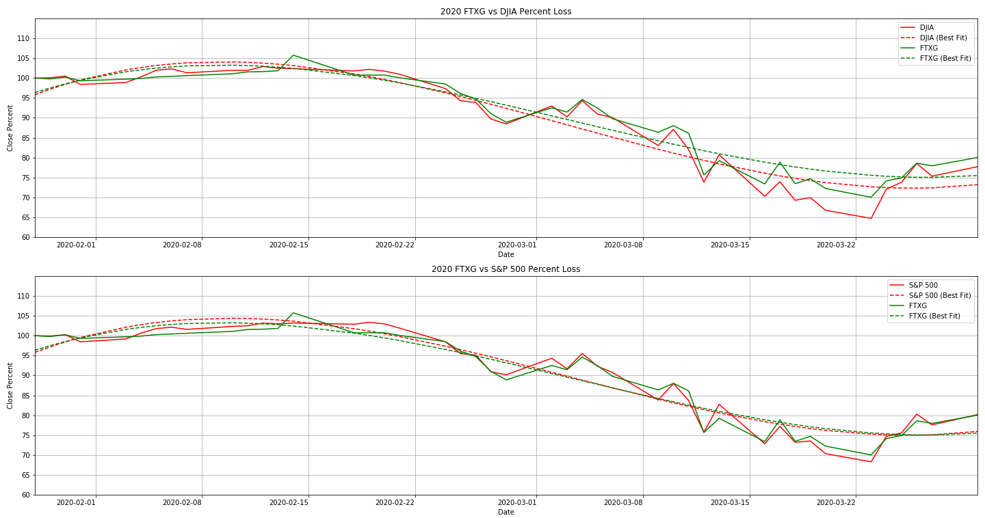
FTXG vs Dow Jones and S&P 500
(Food & Beverage)

Slide 5
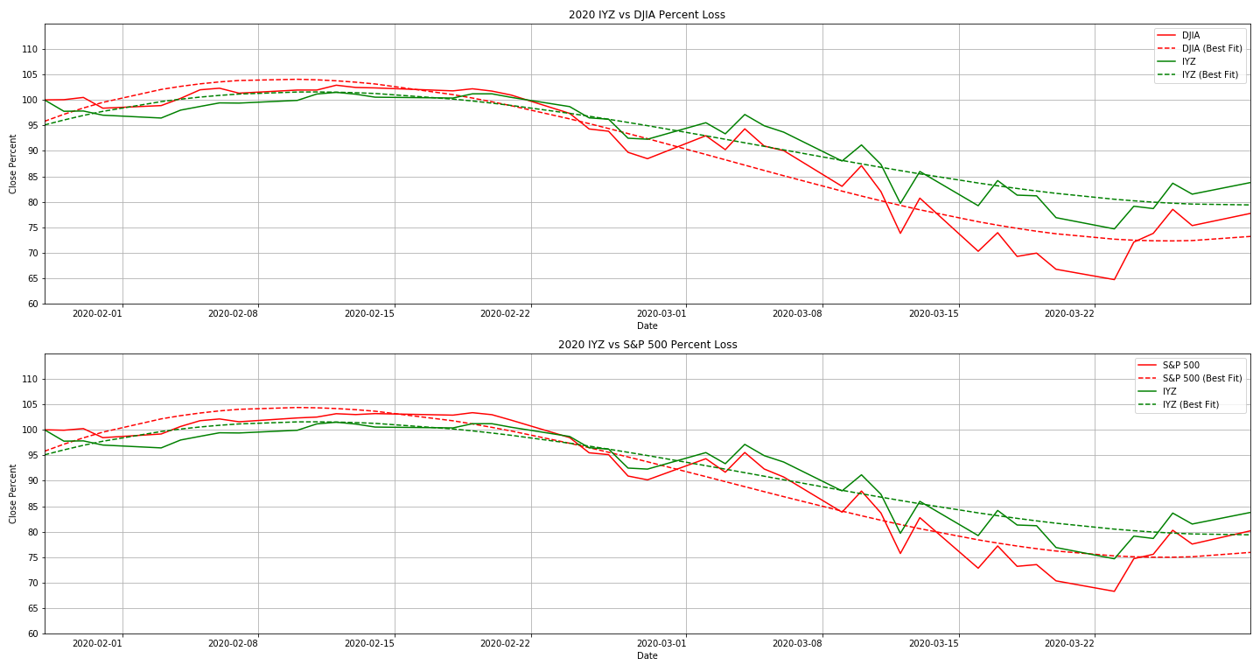
IYZ vs Dow Jones and S&P 500
(Telecommunications)

Slide 6
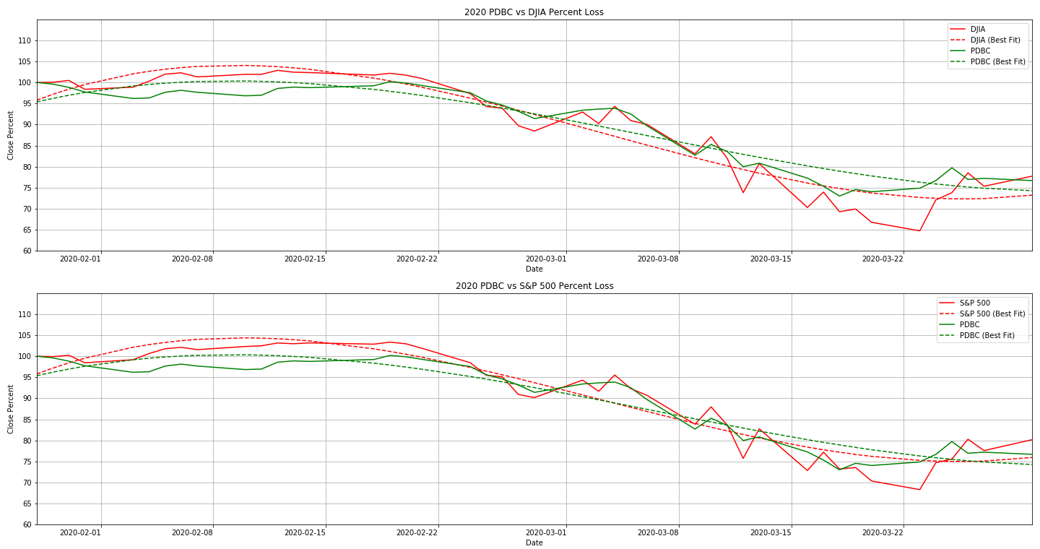
PDBC vs Dow Jones and S&P 500
(Commodities)

Slide 7
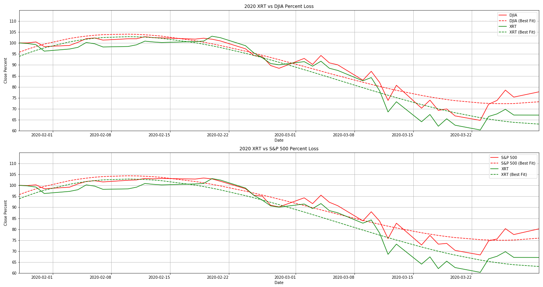
XRT vs Dow Jones and S&P 500
(Retail)

Slide 8
Conclusion
Most markets are performing similarly to the overall indexes.
The Automotive, Food & Beverage, and Commodities Industries/Stocks are performing about the same as the overall market. This isn’t much of a surprise, as some auto manufacturers are retro-fitting equipment to help with the pandemic.
Telecommunications is the only market that has outperformed the market since the crash.
The retail industry has been hit hard. With forced closures of non-essential businesses, and people unable to work, they will be focusing on purchasing only the essentials.
Limitations
Alpha Vantage API does not have access to the NASDAQ index
Used a small sample size, could have compared more ETFs or Stocks
Limited time

